Slide 1
DevOps Industrial Training

Slide 2

Ansible

Slide 3
Scenario
You are DevOps Engineer at IBT technologies, you have been asked to configure 200 ubuntu VMs with
Java JDK
Tomcat

Slide 4

What is Ansible
Ansible is the simplest way to automate apps and IT infrastructure.
Application Deployment + Configuration Management + Continuous Delivery.
Configuration Management : Configuring the system
Orchestration: Brings together number of application and decides the order of execution
Deployment: Automates Deployment of application

Slide 5
How Ansible Helps
Execute tasks from your own machine
Configuration / Installation/ Deployment steps in a single YAML file
Reuse same file for multiple time and for different environment files
More reliable and less likely for ERRORs

Slide 6
Why Ansible
Simplistic
Reliable
Powerfull
Agentless

Slide 7
Comparable Solutions
Puppet
Chef
Salt stack

Slide 8
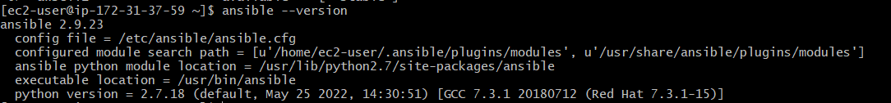
Install Ansible
Windows: https://www.youtube.com/watch?v=4sMFybv74Uo
Mac : brew install ansible (https://formulae.brew.sh/formula/ansible)
Ubuntu Steps:
apt-add-repository ppa:ansible/ansible
apt-get update
apt-get install ansible

Slide 9

Ansible is Agentless
Ansible is Agentless
No
Ansible
No
Ansible
No
Ansible
No
Ansible
Control Machine

Slide 10

SSH – Secured Shell Protocol
Protocol for accessing remote servers.
Connects on port 22 of target machine.
The SSH connection between the client and the server happens in three stages:
Verification of the server by the client.
2.Generation of a session key to encrypt all the communication.
3.Authentication of the client.
How to create key: ssh-keygen –t rsa Enable passwordless authentication

Slide 11
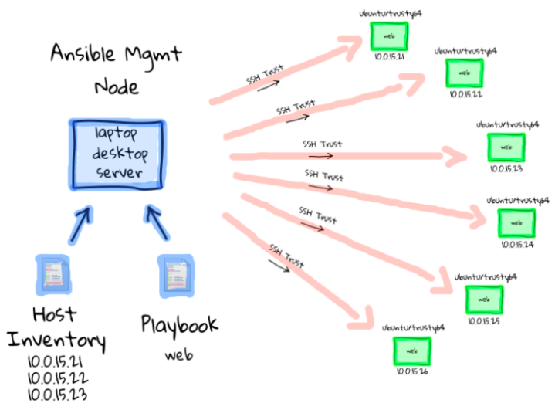

Slide 12
Ansible And DevOps
Ansible is a DevOps Tool
It manages configuration as a code
To do so yaml (yet another markup language) playbooks are typically used
For consistency , playbooks are often provided through git

Slide 13
Control Node
Control node is where the ansible software gets installed

Slide 14
Managed Nodes Requirements
Remote Access
Dedicated user account
Privileged access

Slide 15
Ansible in Nutshell
Ansible Core
An Open-source automation platform
Ansible Tower
Web-based application and Rest API for ansible
Ansible Galaxy
Website with large catalog of community created Roles

Slide 16
Lets Set up Ansible control Node + Managed Node
Digital Ocean – Spin up 2 droplets : ansible-controller + node1
Install ansible on ansible-controller droplet –
apt-get update
apt-add-repository ppa:ansible/ansible
apt-get install ansible
ansible --version
2. Create keys :
ssh-keygen
3. Establish agentless connection with node1 :
ssh-copy-id root@<node1-ipaddress>

Slide 17
Ad-hoc commands –
Playbook –
Multiple servers –
1. /etc/ansible/hosts – default
2. Inventory file users can create
node1 ansible_host=165.227.32.146
node2 ansible_host=159.203.21.147
[nodes]
165.227.32.146
159.203.21.147

Slide 18
Inventory
To Identify managed Hosts
To Define host group to be used by ansible
To define a variable
Default inventory /etc/ansible/hosts
Project based inventory can be define with -i flag (-i <inventoryFileName>)

Slide 19
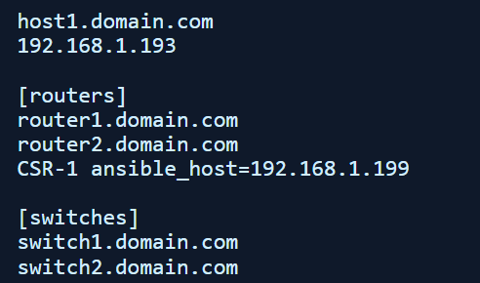
Understanding Ansible Hosts
The Ansible inventory file defines the hosts and groups of hosts upon which commands, modules, and tasks in a playbook operate.
The default inventory file is named hosts by default and is one of the default files installed with Ansible – the other main one being ansible.cfg.

Slide 20
syntax
ansible pattern module command
ansible
[webservers]
abcd[001-100].fg.org.com

Slide 21
Understanding Ad-Hoc commands
Command line solution to perform ansible task on managed hosts
Modules are used in ansible ad-hoc commands
In and after ansible 2.10 modules are part of collection
Collection name FQCN is used like ansible.build.command
Other commands
Ansible.build.shell
Ansible.build.user
ansible.build.copy
https://docs.ansible.com/ansible/2.9/modules/list_of_all_modules.html

Slide 22
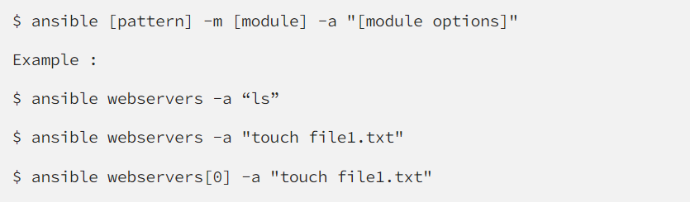
Ad Hoc Commands
An Ansible ad hoc command uses the /usr/bin/ansible command-line tool to automate a single task on one or more managed nodes.
Ad hoc commands are runs individually to perform quick functions and it can’t be reusable .
Ad hoc commands are great for tasks you repeat rarely you could execute a quick one-liner in Ansible without writing a playbook.
Idempotency is present in adhoc command.
These commands are not used for configuration management and deployment, because they are uses one time.

Slide 23
Ad Hoc Commands
An Ansible ad hoc command uses the /usr/bin/ansible command-line tool to automate a single task on one or more managed nodes.
Ad hoc commands are runs individually to perform quick functions and it can’t be reusable .
Ad hoc commands are great for tasks you repeat rarely you could execute a quick one-liner in Ansible without writing a playbook.
Idempotency is present in adhoc command.
These commands are not used for configuration management and deployment, because they are uses one time.
Scenario: When you have to reboot all your company servers ,power off all the machines and many more task to perform there we can use adhoc command

Slide 24
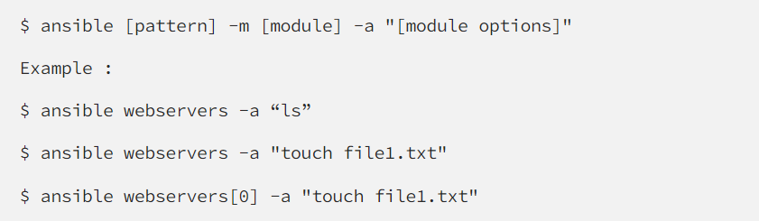
Ad Hoc Commands - Syntax
here webservers [0] means it will create file in the first node of webservers.
We can perform operation on particular node then we can pass argument in “ [ ] “.
Let there are 10 node in a group and you perform some task on starting 5 node then argument we can pass as “ [0–4]”.
webservers[-1] refer the last node of the group.
When we use ad-hoc commands and if we do not provide the module name, the “command” module will be used by default

Slide 25
Ansible - Module
Modules are like small programs that Ansible pushes out from a control machine to all the nodes or remote hosts.
It can be written in the from of command line or in a playbook task.
When using command line then we pass command by “-m “.
Ansible executes all the modules for installing updates or whatever the required task is, and then removes them when finished.
Ansible executes each module, usually on the remote target node, and collects return value in JSON format.
Idempotency is present in module.
Each module supports taking arguments. Mainly all modules take key=value arguments, space delimited.
ansible nodes -m service -a "name=httpd state=started“
ansible nodes -m ping ansible nodes –m copy -a "src =copy.txt dest=/root"

Slide 26
Ansible Modules
System :
User
Group
Hostname
Iptable
Make
Mount
Ping
Timezone
Systemd
Service
Command :
Command
Expect
Raw
Script
Shell
File :
Acl
Archive
Unarchive
Copy
File
Find
Lineinfile
Replace
Stat
Template
Database :
MongoDB
Mssql
Postgreswl
Proxysql
vertica
Cloud :
Amazon
Atomic
Azure
Digital Ocean
Docker
Google
Openstack
VMWare
Smartos
Windows :
Win_copy
Win_command
Win_domain
Win_file
Win_ping
Win_package
Wind_service
Win_user

Slide 27
Things to know about Modules
Also referred as task plugins or library plugins
Default location for Ansible modules is /usr/share/ansible
Take arguments in key=value format (state=stopped)
Returns data in JSON format
Modules should be idempotent, meaning they should not do any changes if current state of system matches with the desired final state
To access list of all installed modules using command line: ansible-doc -l
To see the documentation of particular module using command line: ansible-doc yum where yum is the module name
You can run modules from the command line or include them in Playbook

Slide 28
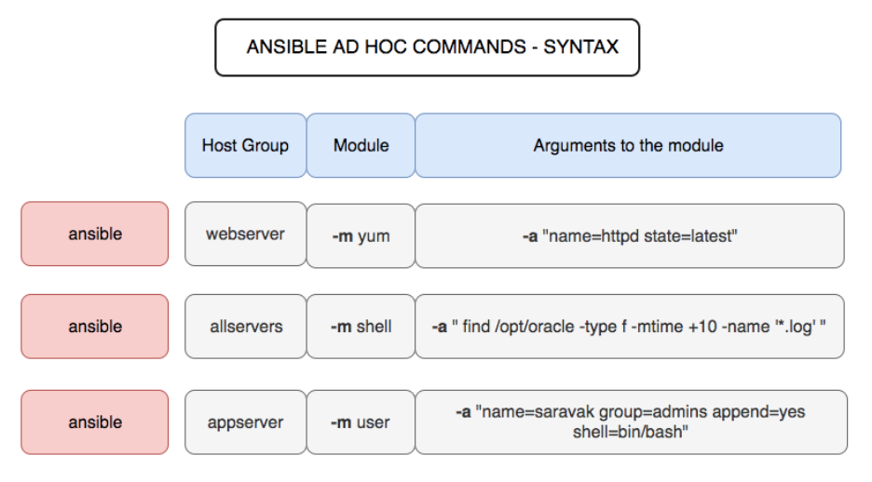
Ad-hoc Command

Slide 29
Ad Hoc Commands…Contd.
Function | Command
To check the connectivity of hosts | #ansible <group> -m ping
To reboot hosts | #ansible <group> -a “/bin/reboot”
To check the host system’s info | #ansible<group> -m steup | less
To transfer files | #ansible <group> -m copy -a “src=home/ansible dest=/tmo/home”
To create a new user | #ansible<group> -m user -a “name=ansible password= <encrypted password>”
To delete a user | #ansible<group> -m user -a “name=ansible state- absent”
To check if a package is installed and to update it | #ansible<group> -m apt -a “name=httpd state=latest”
To check if a package is installed but not to update it | #ansible<group> -m yum -a “name=httpd state=present”
To check if a package is of a specific version | #ansible<group> -m yum -a “name=httpd-1.8 state=latest”
To check if a package is not installed | #ansible <group> -m yum -a “name= httpd state= absent
To start a service | #ansible<group> -m service -a “name= httpd state=”started”
To stop a service | #ansible<group> -m service -a “name= httpd state=”stopped”
To restart a service | #ansible<group> -m service -a “name= httpd state=”restarted”

Slide 30
Ansible - Module
Ansible Ad Hoc Command to Copy a File as Sudo User to Target
ansible uaans69 -b -m copy -a 'src=/etc/hosts dest=/etc/hosts'
Ansible Module to Copy a File as Sudo User to Target
--- - hosts: web user: root become: yes connection: ssh tasks: - name: Copy file with owner and permissions copy: src: ./filesend2.txt dest: /Downloads owner: root group: root mode: '0644'

